Slide 1
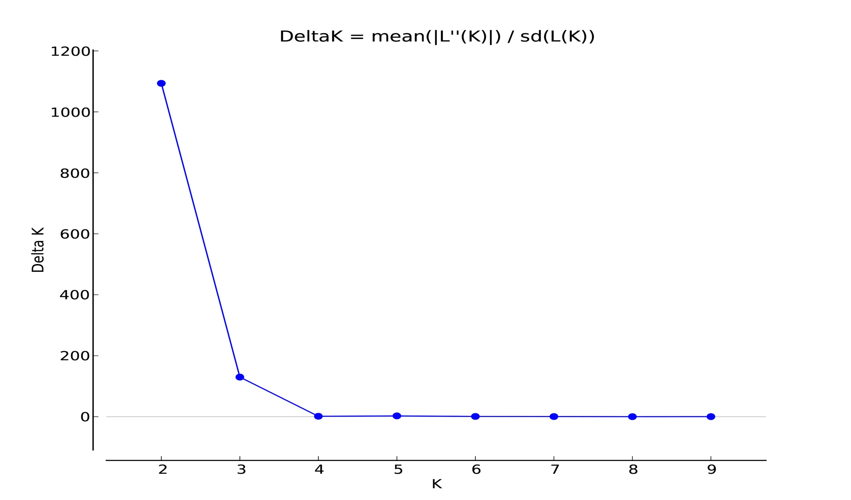
Additional file 5: Fig. S2 Estimation of the optimal number of populations (K) using the deltaK/K method.

